Slide 1



Patch Diffusion: Faster and More Data-Efficient Training of Diffusion Models
Zhendong Wang^{1,2}, Yifan Jiang¹, Huangjie Zheng^{1,2}, Peihao Wang¹, Pengcheng He², Zhangyang Wang¹, Weizhu Chen², and Mingyuan Zhou¹
¹The University of Texas at Austin, ²Microsoft Azure AI
Accepted in NeurIPS 2023
Presenter: Changyong Choi

Slide 2
■
Index
Introduction
Related Work
Patch Diffusion Training
Experiments
Conclusion and Future Work

Slide 3
■
Introduction
Diffusion models have found great success in a wide range of applications. → unconditional image synthesis, text-to-image generation, audio generation, etc.
1) They are slow in generation due to the need to traverse the reverse diffusion chain. → DDIM, TDPM, DPM-Solver, and EDM-Sampling. 2) diffusion models are also expensive and data-hungry to train. They require large datasets and many iterations.
To democratize diffusion model training, patch-wise diffusion training (Patch Diffusion) is proposed. → A plug-and-play training technique that is agnostic to any choice of UNet architecture, sampler, noise schedule, and so on.
Instead of learning the score function on the full-size image for each pixel, Learning a conditional score function on image patches, where both patch location and patch size are the conditions.
Main contributions are summarized as follows: 1. The first patch-level training framework, generally applicable to diffusion models, that targets saving training time and data costs. 2. Novel strategies of patch coordinate conditioning and patch size conditioning/scheduling, to balance training efficiency and effective global structure encoding. 3. Competitive results while generally halving the training time, and notable performance gains at small training data regimes.

Slide 4
■
Related Work
Preliminaries for diffusion models.
Diffusion probabilistic models first construct a forward process, then reverse the forward process to reconstruct it. Forward process: iteratively applies noise to the given images. Reverse process: iteratively denoises a noisy observation.
Data-efficient training in generative models.
Many explorations have been conducted on limited data or even the few-shot setting of generative model’s training schemes in Generative Adversarial Networks (GANs).
To avoid expensive data collection, 1) Differentiable augmentation (DiffAugment) 2) Adaptive augmentation strategy (StyleGAN2-ADA) 3) Diffusion-GAN and more…

Slide 5
■
Related Work
Resource-efficient training in generative models.
To address the issue of mode collapse given limited training data, * GAN 1) Anycost-GAN: different levels of cost during inference 2) Coco-GAN: the patch-wise training scheme 3) IRN-GAN: the patch-wise training scheme 4) Chai at al.¹: any resolution framework * Diffusion 1) Latent Diffusion: perform diffusion in a latent space instead of the pixel space 2) Other works ^{2,3,4,5,6} : study the fast sampling strategy at the inference stage, which does not directly help speed up the training process.
¹ Chai, L., Gharbi, M., Shechtman, E., Isola, P., and Zhang, R. Any-resolution training for high-resolution image synthesis. arXiv preprint arXiv:2204.07156, 2022.
² Bao, F., Li, C., Sun, J., Zhu, J., and Zhang, B. Estimating the optimal covariance with imperfect mean in diffusion probabilistic models. arXiv preprint arXiv:2206.07309, 2022.
³ Bao, F., Li, C., Zhu, J., and Zhang, B. Analytic-dpm: an analytic estimate of the optimal reverse variance in diffusion probabilistic models. arXiv preprint arXiv:2201.06503, 2022.
⁴ Lu, C., Zhou, Y., Bao, F., Chen, J., Li, C., and Zhu, J. Dpm-solver: A fast ode solver for diffusion probabilistic model sampling in around 10 steps. arXiv preprint arXiv:2206.00927, 2022.
⁵ Lu, C., Zhou, Y., Bao, F., Chen, J., Li, C., and Zhu, J. Dpm-solver++: Fast solver for guided sampling of diffusion probabilistic models. arXiv preprint arXiv:2211.01095, 2022.
⁶ Song, J., Meng, C., and Ermon, S. Denoising diffusion implicit models. arXiv preprint arXiv:2010.02502, 2020.

Slide 6
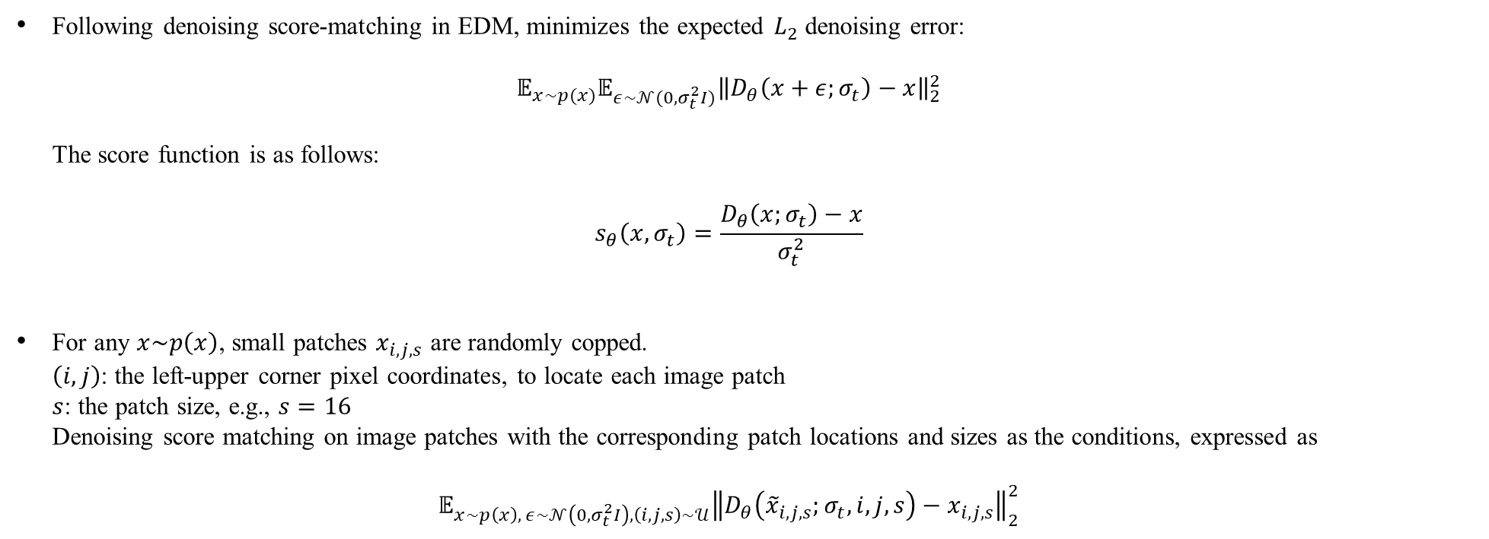
■
Patch Diffusion Training
Patch-wise Score Matching
Following denoising score-matching in EDM, minimizes the expected $L_{2}$ denoising error: $𝔼_{x\sim p(x)}𝔼_{ε\sim 𝒩(0,σ_{t}^{2}I)}{\left\|D_{θ}\left(x+ε;σ_{t}\right)−x\right\|}_{2}^{2}$ The score function is as follows: $s_{θ}\left(x,σ_{t}\right)=\frac{D_{θ}\left(x;σ_{t}\right)−x}{σ_{t}^{2}}$
For any $x\sim p\left(x\right)$, small patches $x_{i,j,s}$ are randomly copped. $\left(i,j\right)$: the left-upper corner pixel coordinates, to locate each image patch $s$: the patch size, e.g., $s=16$ Denoising score matching on image patches with the corresponding patch locations and sizes as the conditions, expressed as $𝔼_{x\sim p\left(x\right), ε\sim 𝒩\left(0,σ_{t}^{2}I\right), \left(i,j,s\right)\sim 𝒰}{\left\|D_{θ}\left({\tilde{x}}_{i,j,s};σ_{t}, i, j, s\right)−x_{i,j,s}\right\|}_{2}^{2}$

Slide 7
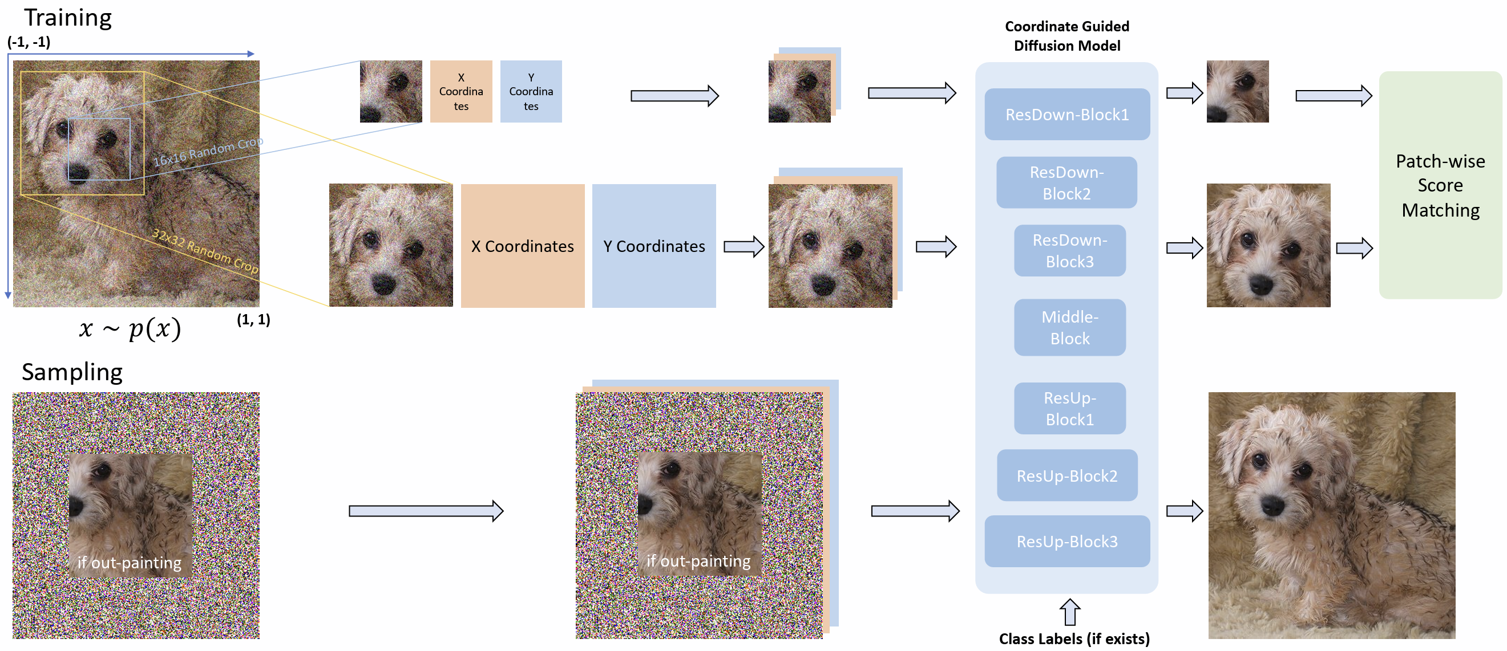
■
Patch Diffusion Training
Patch-wise Score Matching

Slide 8
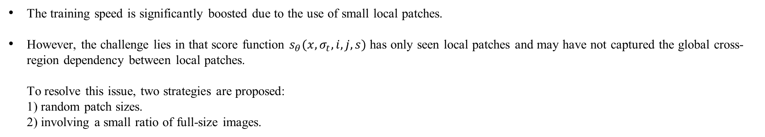
■
Patch Diffusion Training
Patch-wise Score Matching
The training speed is significantly boosted due to the use of small local patches.
However, the challenge lies in that score function $s_{θ}(x, σ_{t}, i, j, s)$ has only seen local patches and may have not captured the global cross-region dependency between local patches. To resolve this issue, two strategies are proposed: 1) random patch sizes. 2) involving a small ratio of full-size images.

Slide 9
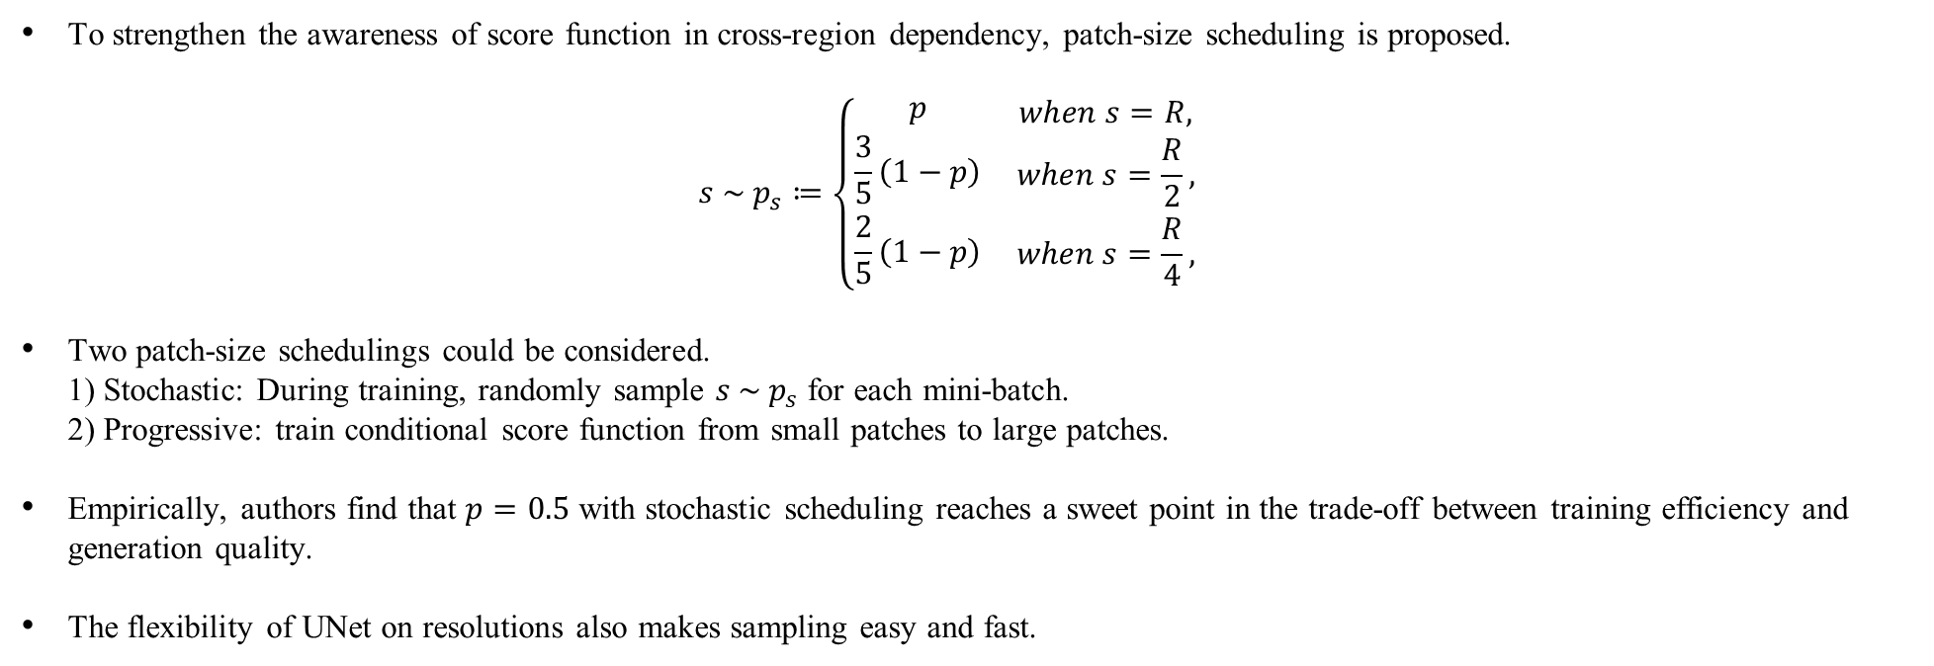
■
Patch Diffusion Training
Progressive and Stochastic Patch Size Scheduling
To strengthen the awareness of score function in cross-region dependency, patch-size scheduling is proposed. $s \sim p_{s}≔\left\{\begin{aligned}p \\ \frac{3}{5}\left(1−p\right) \\ \frac{2}{5}\left(1−p\right)\end{aligned}\right. \begin{matrix}when s=R, \\ when s=\frac{R}{2}, \\ when s=\frac{R}{4},\end{matrix}$
Two patch-size schedulings could be considered. 1) Stochastic: During training, randomly sample $s \sim p_{s}$ for each mini-batch. 2) Progressive: train conditional score function from small patches to large patches.
Empirically, authors find that $p=0.5$ with stochastic scheduling reaches a sweet point in the trade-off between training efficiency and generation quality.
The flexibility of UNet on resolutions also makes sampling easy and fast.

Slide 10
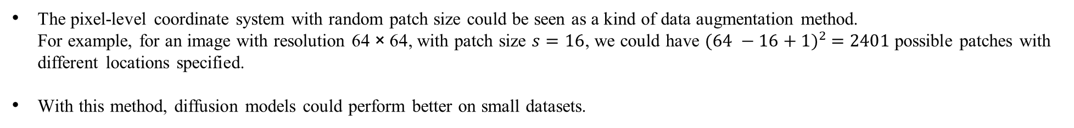
■
Patch Diffusion Training
Conditional Coordinates for Patch Location
The pixel-level coordinate system with random patch size could be seen as a kind of data augmentation method. For example, for an image with resolution 64 × 64, with patch size $s=16$, we could have ${(64 −16+1)}^{2} =2401$ possible patches with different locations specified.
With this method, diffusion models could perform better on small datasets.
Sampling
By utilizing coordinate system and the UNet, we can easily accomplish the reverse sampling.
We compute and parameterize the coordinates for the full image, and concatenate them together with the image sample at each reverse iteration.

Slide 11
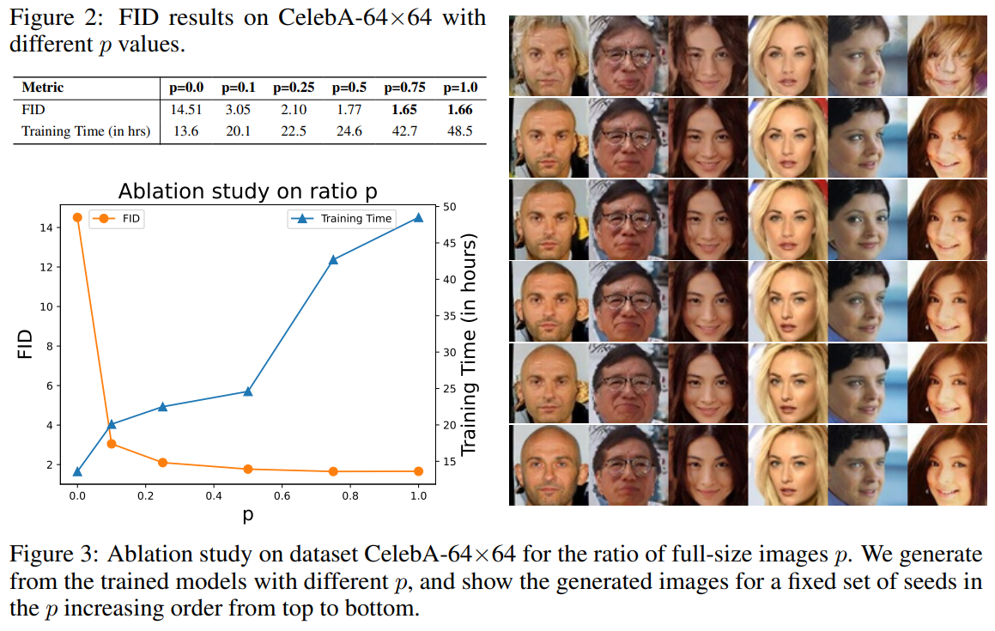
■
Experiments
Ablation study
All models are trained on 16 Nvidia V100 GPUs with a batch size of 512 for a duration of 200 million images.

Slide 12
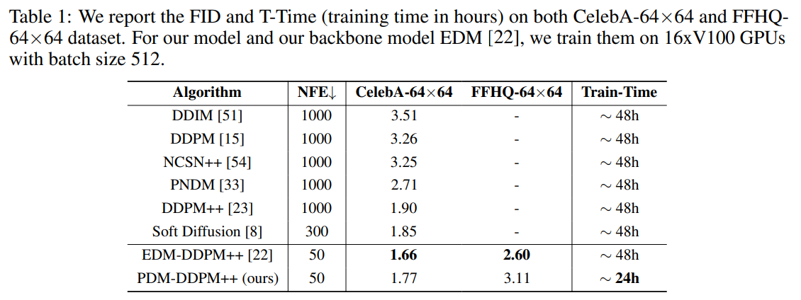
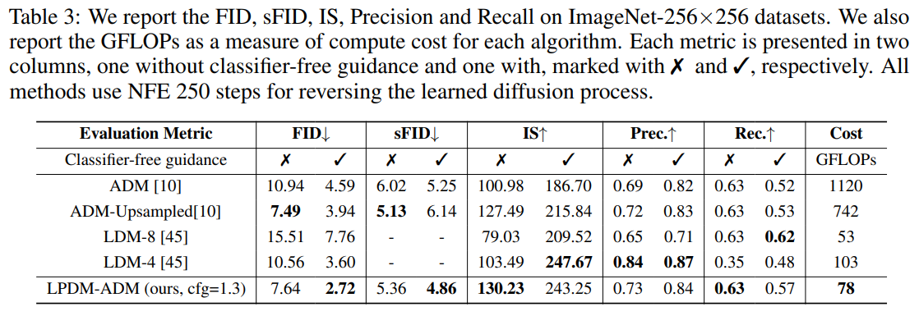
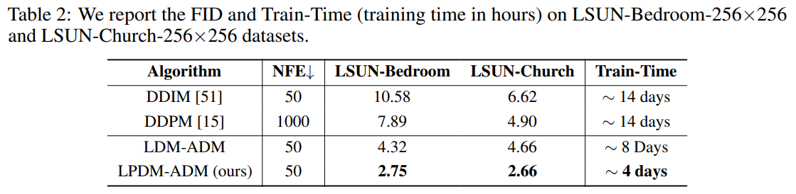
■
Experiments
Experiments on Large-scale Dataset

Slide 13
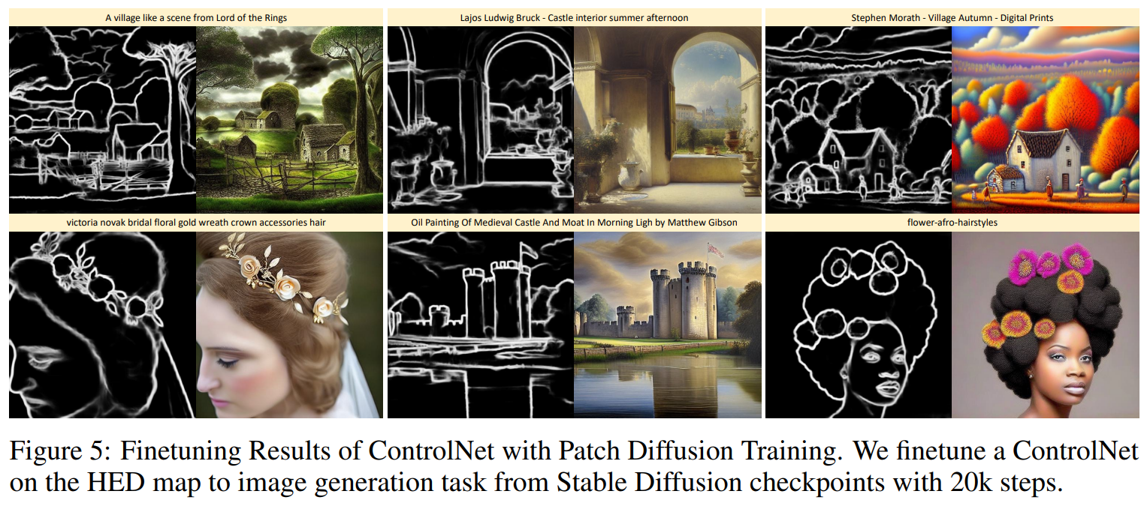
■
Experiments
Experiments on Finetuning

Slide 14
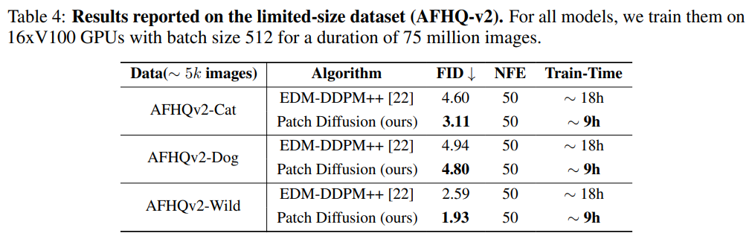
■
Experiments
Experiments on Limited-size Dataset

Slide 15
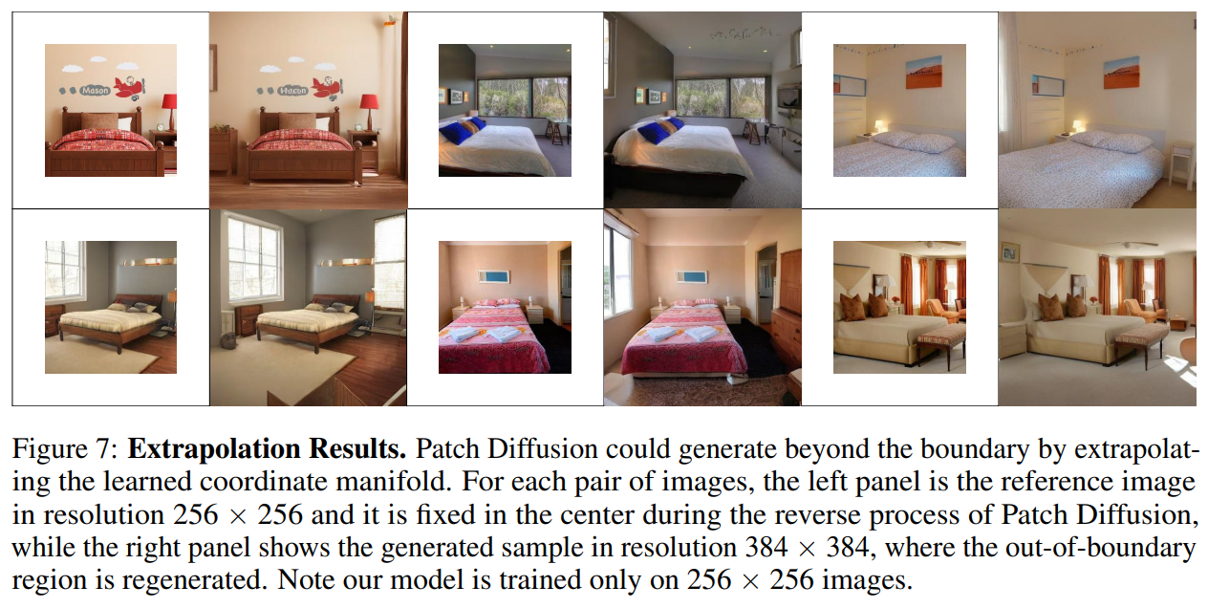
■
Experiments
Experiments on Image Extrapolation

Slide 16
■
Conclusion and Future Work
Patch Diffusion, a novel patch-level training framework that trains diffusion models via coordinate conditioned score matching, is presented.
For score matching in a progressive or stochastic schedule during training, diversifying the patch sizes is proposed.
Sampling with this method is as easy as in the original diffusion model.
Patch Diffusion could significantly reduce the training time costs, e.g., 2× faster training, while improving the data efficiency of diffusion models.
Going forward, the current coordinate system could be further improved by advanced positional embeddings.
Authors also leave the theoretical proof of the convergence of patch-wise score matching in general cases as future work.

Slide 17
Thank you

